Slide 1


Robust Data Hiding Using Inverse Gradient Attention
This presentation introduces a novel deep data hiding scheme that leverages Inverse Gradient Attention (IGA) to enhance robustness and capacity. We explore how this method outperforms existing deep learning-based approaches by intelligently assigning attention weights to pixels, ensuring data recovery even under various distortions.
by PAVAN ARAVAPALLI

Slide 2
Understanding Data Hiding
Core Purpose
Key Metrics
Data hiding embeds information into cover media like images without noticeable perceptual changes. The hidden messages must be robustly reconstructable even after intentional distortions.
Robustness: Reliability of message reconstruction under image transformations.
Imperceptibility: Similarity between the cover and encoded image.
This field encompasses digital watermarking for intellectual property protection and steganography for encrypted transmission.
Capacity: Amount of information embedded.

Slide 3
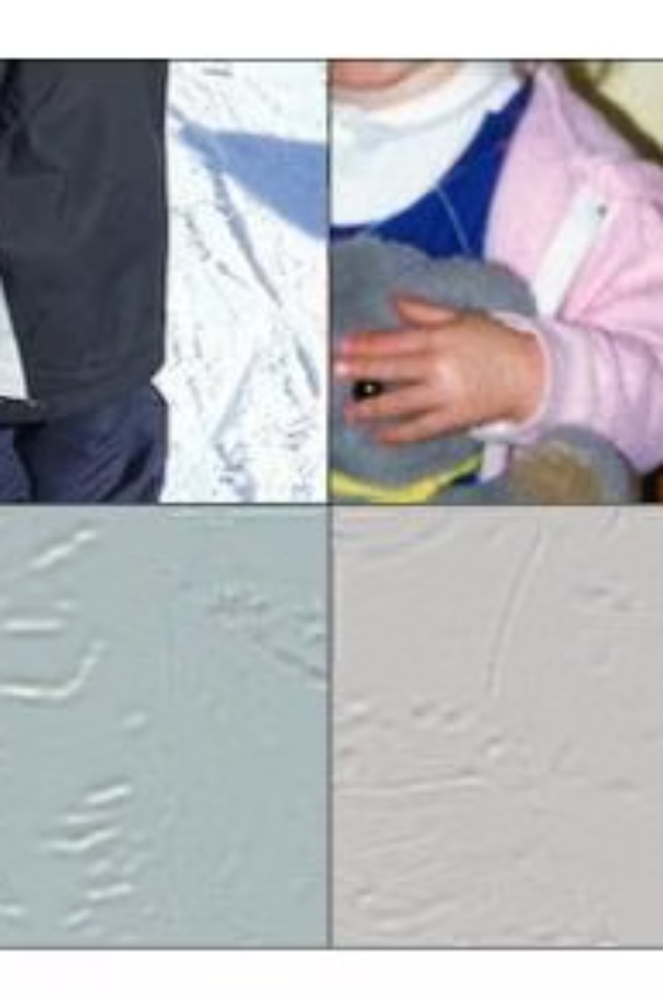
Introducing Inverse Gradient Attention (IGA)
Our novel deep data hiding scheme, Inverse Gradient Attention (IGA), combines the attention mechanism to assign different attention weights to pixels. This allows the model to spotlight pixels with more robustness for data hiding.
The IGA mask is derived from pixel gradients towards message reconstruction, avoiding extra parameters and offering greater explainability than black-box models.

Slide 4
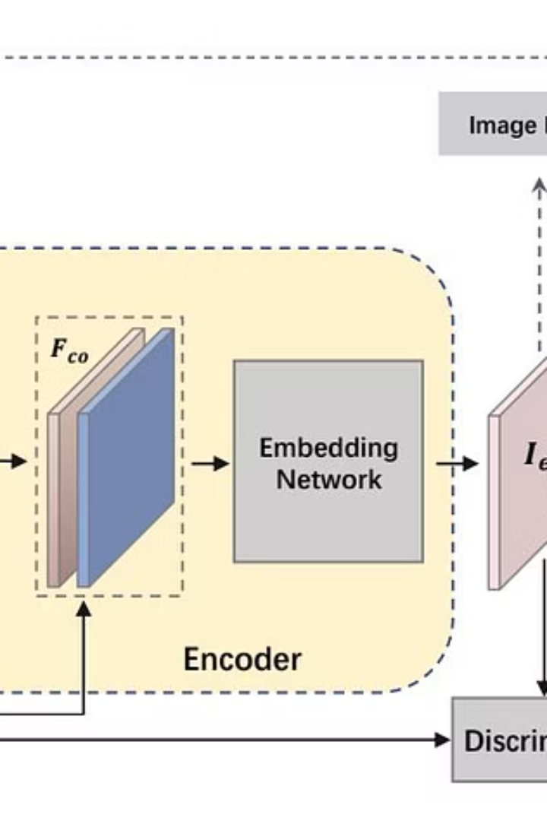
Proposed Model Architecture
Our model enhances the classic Encoder-Decoder framework with two novel components: a message coding module and an inverse gradient attention module.
The message coding module compresses lengthy binary messages into real-value representations, improving capacity and robustness. The inverse gradient attention module identifies robust pixels for data hiding, offering interpretability without additional parameters.

Slide 5
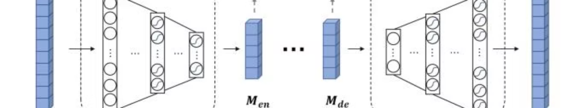
Message Coding Module Explained
To enhance capacity and imperceptibility, we introduce a message coding module. This module maps lengthy binary messages into a more condensed real-value representation before embedding.
Utilizing a symmetric encoder-decoder structure with multi-layer perceptrons (MLPs), it reduces disturbance and allows for embedding more information. This differs from channel coding by focusing on dimension reduction for capacity, not just redundancy.

Slide 6
Experimental Results: Robustness
Our IGA model consistently outperforms mainstream data hiding methods across various message lengths and image distortions on both COCO and DIV2K datasets. Notably, for longer messages (k=90), our model shows significant improvement in robustness.
This demonstrates the effectiveness of our inverse gradient attention mechanism in identifying and utilizing robust pixels for message embedding, surpassing traditional black-box attention models.
Methods
COCO
DIV2K
k
Identity
Crop
Cropout
Dropout
Resize
Jpeg
CN
Identity
Crop
Cropout
Dropout
Resize
Jpeg
CN
HiDDeN
30
98.10
80.34
75.96
76.89
82.72
84.09
76.30
73.72
68.24
60.92
63.78
66.28
66.37
58.05
64
79.82
72.52
63.20
68.53
69.35
68.85
65.46
70.45
51.60
51.09
52.40
50.81
50.99
52.35
90
73.56
65.46
60.20
61.49
63.03
63.21
62.07
58.04
50.63
51.50
50.22
51.40
51.16
51.84
ABDH
30
98.70
85.16
74.82
75.31
80.23
82.62
74.01
81.09
62.24
59.71
58.72
60.83
63.44
63.58
64
85.93
67.14
59.96
62.62
62.02
61.74
59.14
64.58
51.69
52.21
53.32
55.20
52.72
50.78
90
72.22
52.65
51.99
52.88
52.95
53.04
52.25
56.44
51.48
51.67
51.28
51.15
51.19
50.23
DA
30
99.50
81.15
78.58
77.13
81.72
82.83
75.73
78.80
77.32
77.11
74.55
71.01
82.35
63.85
64
77.18
68.68
65.82
73.00
62.54
73.58
64.90
62.01
62.65
61.79
71.09
58.91
71.26
53.31
90
70.82
63.51
61.08
64.28
62.62
67.00
63.21
57.88
58.12
54.18
57.32
55.68
62.17
53.05
IGA (Ours)
30
99.96
86.88
79.33
77.51
81.44
87.35
82.30
79.94
77.39
60.93
76.63
72.19
82.90
64.14
64
94.34
73.34
66.82
70.23
69.41
72.07
78.38
77.61
63.11
62.00
70.14
59.64
72.31
57.03
90
74.62
69.45
62.52
64.96
65.78
68.78
71.47
62.26
59.10
55.31
60.10
56.48
63.21
55.32

Slide 7
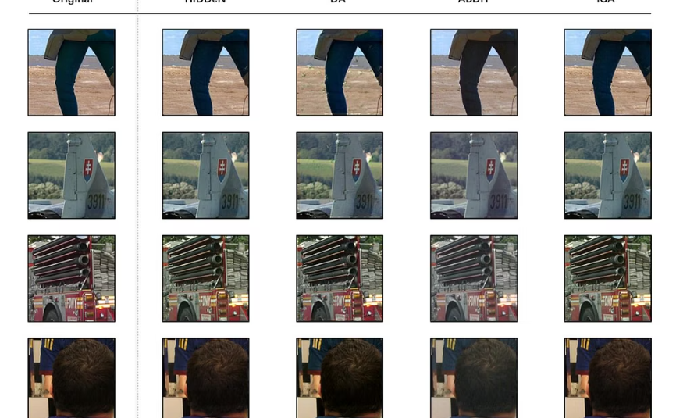
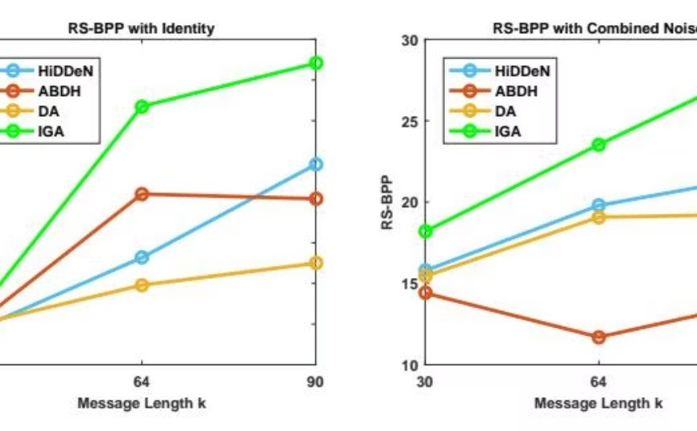
Imperceptibility and Capacity
Our IGA model achieves comparable imperceptibility with existing methods, producing encoded images that are visually indistinguishable from original cover images. This is crucial for practical data hiding applications.
Furthermore, IGA significantly improves model capacity, enabling the embedding of more information without compromising image quality, as evidenced by higher RS-BPP values across various settings.
Visual Imperceptibility
Enhanced Capacity
Encoded images generated by IGA are visually similar to original cover images, ensuring minimal perceptual disturbance.
IGA demonstrates significantly higher RS-BPP values, indicating its superior ability to embed lengthy messages robustly.

Slide 8
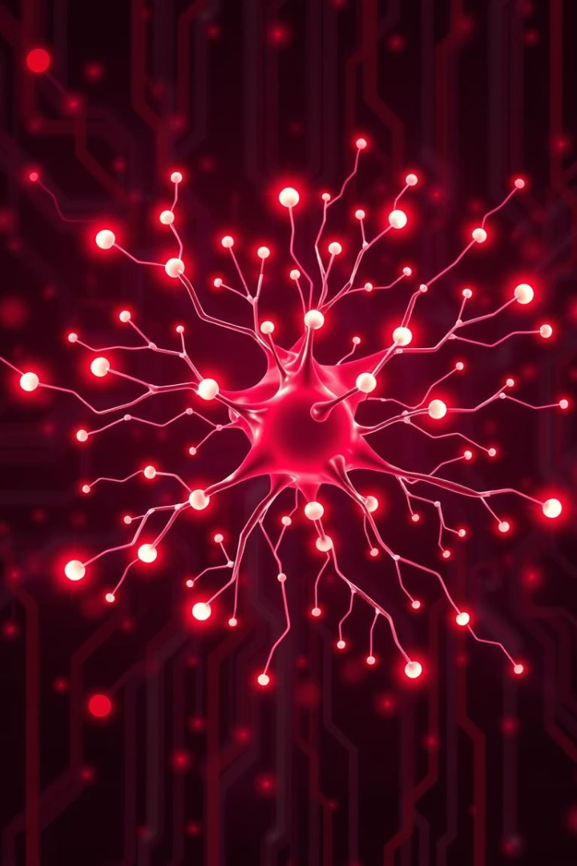

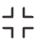


Key Takeaways and Future Work
Novel IGA Mechanism
Our Inverse Gradient Attention (IGA) module adaptively spotlights robust pixels for data hiding, significantly improving accuracy and robustness against distortions.
Message Coding Module
The symmetric message coding module enhances capacity and robustness by mapping binary messages to a compact real-value space.
Superior Performance
Extensive experiments confirm IGA's superior performance over current mainstream data hiding models in robustness, imperceptibility, and capacity.
Future Directions
Future work will explore deeper neural networks for message coding to further accelerate convergence and boost generalization capabilities.

